Slide 1
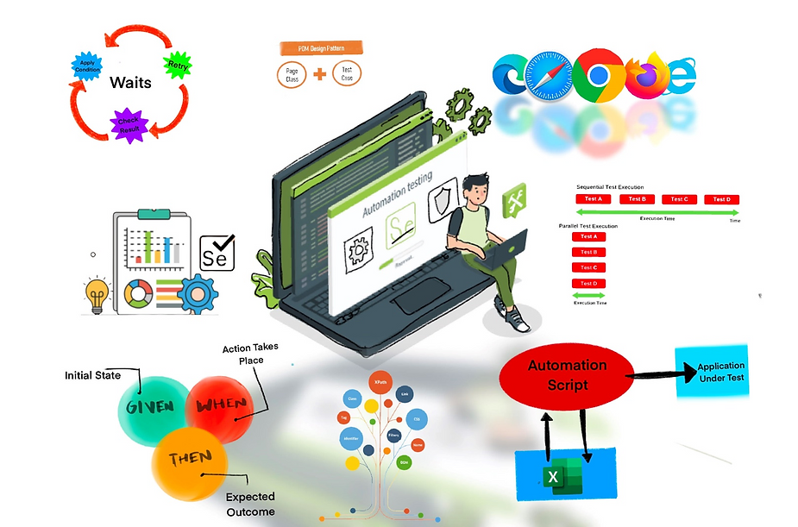
Java Selenium Framework with Automated Test Distribution and Full Resource Utilization
Prepared for: John Doe, VP of QA
Prepared by: Siva Teja Mundlamuri
Team Lead
WeThink Technology Solutions

Slide 2

Contents:
Introduction
Problem Description
System Overview
Functional Model
Structural Model
Behavioral Model
Design Model
Data Management Layer Design
Human-Computer Interaction Layer Design
Physical Architecture Layer Design
Acknowledgement
Conclusion

Slide 3
Introduction:
I am going to explain about my project Java Selenium Framework with Automated Test Distribution and with Full Resource Utilization.
My project is related to the field of software web application testing.
The Motivation for this project is during my work experience as automation tester I have observed some challenges in frameworks that I am working on, so I decided to develop a framework to overcome all the challenges.

Slide 4
Problem Description:
The current automation testing Framework’s in the market faces 3 main challenges such as
Underutilization of System Resources: The existing frameworks are not utilizing the system resources fully; due to this it is taking longer test case execution times which in turn results in delays in code deployment.
Manual Distribution of testcases: In software industry testcases are distributed manually to different systems and then performs testcase execution, due to this it leads to wastage in human effort.
Inefficient in test execution Report generation: when we run testcases in different systems the Test execution reports are fragmented in different system and do not provide a unified view of test execution report.

Slide 5
System Overview:
The project "Java Selenium Framework with Automated Test Distribution and Full Resource Utilization" aims to enhance automated testing framework efficiency.
Focusing on Automated test distribution by using selenium Grid Feature.
Full system resource utilization by running testcases in parallel by checking system CPU and memory utilization.
Unified test execution report by consolidating all the reports of every system on which testcases are executed.
Note: It significantly reduces test execution times, optimizes resource allocation, and ensures scalability for complex web applications, ultimately streamlining the testing process and accelerating market readiness.

Slide 6
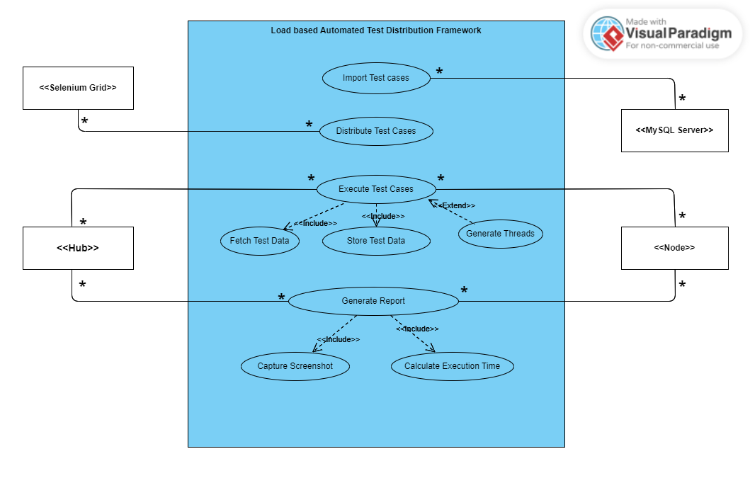
Functional Model:
Use-Case diagram:
The "Use-Case diagram" is revolving around three primary functionalities of a Load based Automated Test Distribution Framework: "Import Testcases", "Distribute Test Cases", and "Execute Test Cases". Each functionality involves different system actors like MySQL server, Selenium Grid, Hub, and Node.
Fig: Use case Diagram of Load Based Automated Test Distribution Framework.

Slide 7
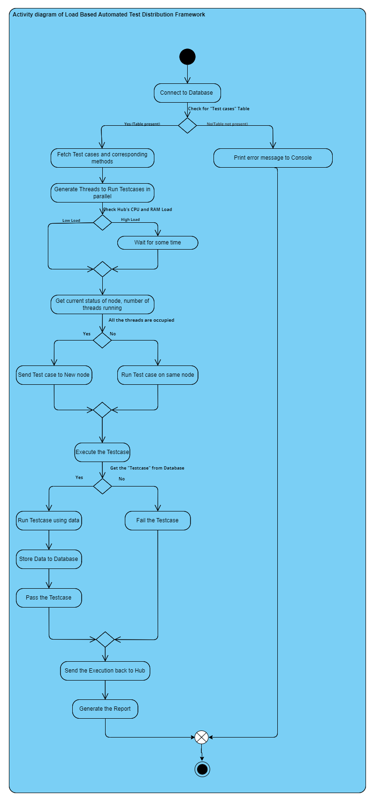
Activity diagram:
I have implemented the activity diagram of whole system; The activity diagram has all the following use cases implemented in it.
Import Test Cases
Distribute the testcases
Execute testcase
Generate Report
Fig: Activity Diagram of Load Based Automated Test Distribution Framework

Slide 8
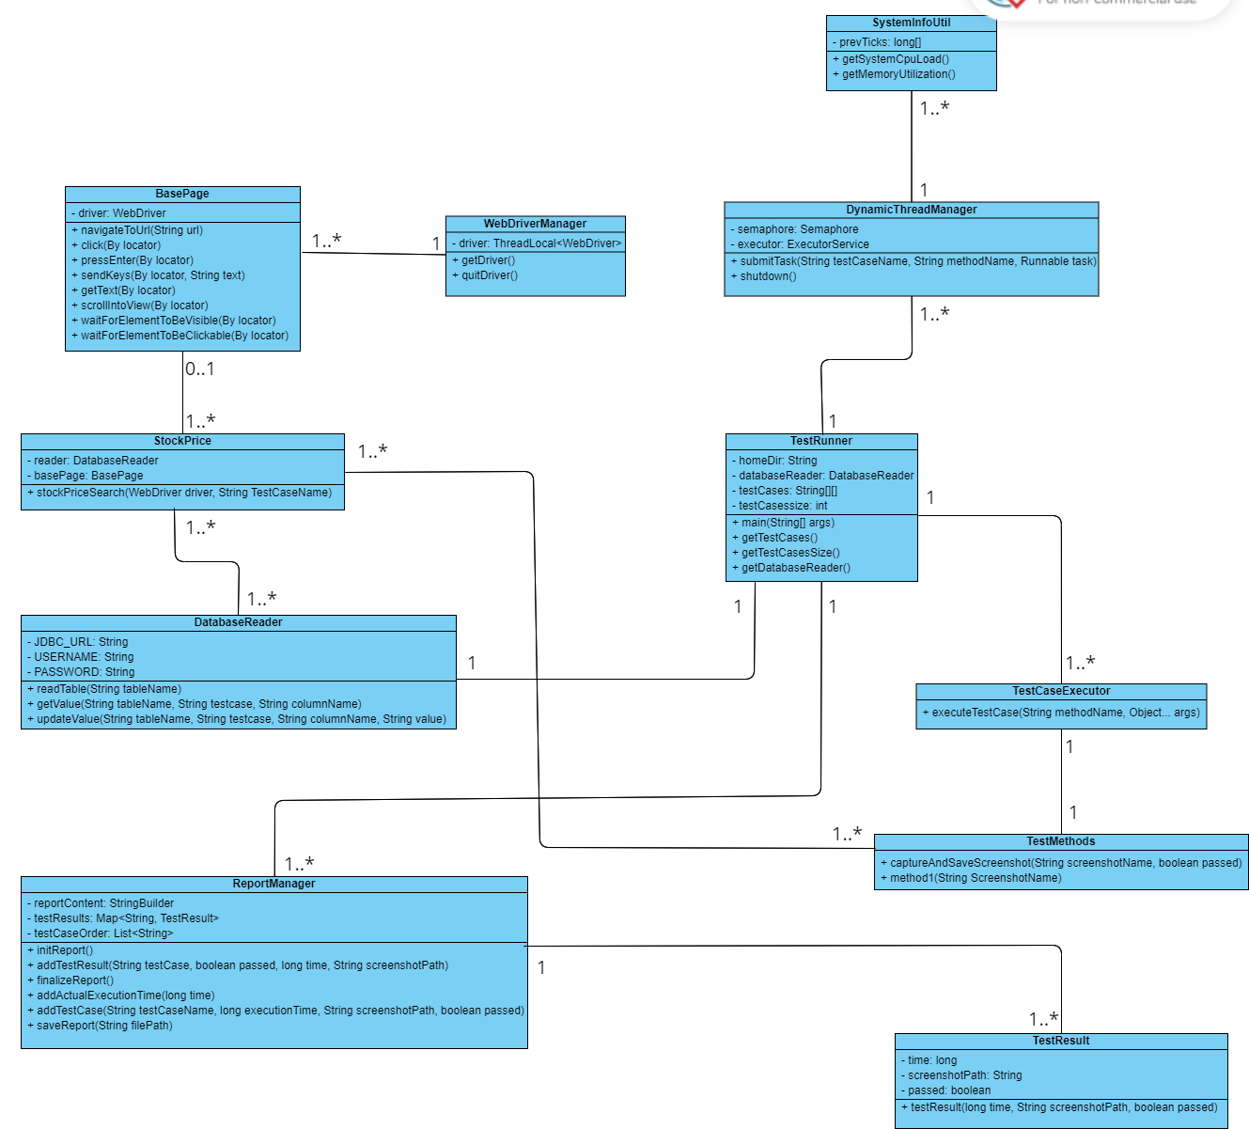
Structural Model:
The "Structural Model" provides an in-depth view of the Load Based Automated Test Distribution Framework, depicted through class and object diagrams.
Class diagram: The class diagram illustrates the system's architecture, showing classes, their attributes, methods, and interconnections. It serves to clarify how various components like BasePage, WebDriverManager, and TestRunner etc.. are structured and relate to each other.
Fig: Class diagram of Load Based Automated Test Distribution Framework.

Slide 9
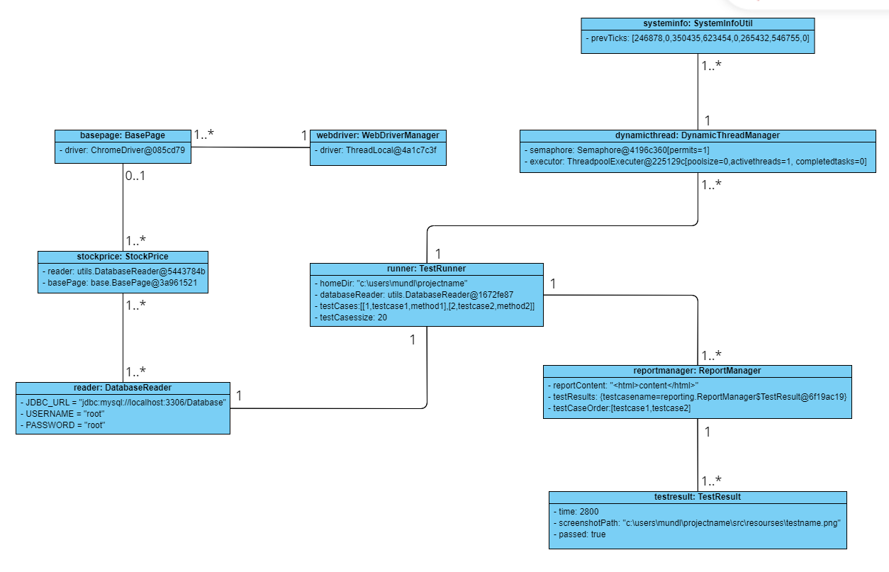
Object diagram:
The object diagrams are specific instances of the classes. For instance, the runner object is a specific instance of the TestRunner class with particular values for its attributes. The same goes for objects of BasePage, WebDriverManager, DynamicThreadManager, ReportManager, StockPrice, TestCaseExecutor, TestMethods, DatabaseReader and SystemInfoUtil.
Fig: Object diagram of Load Based Automated Test Distribution Framework

Slide 10
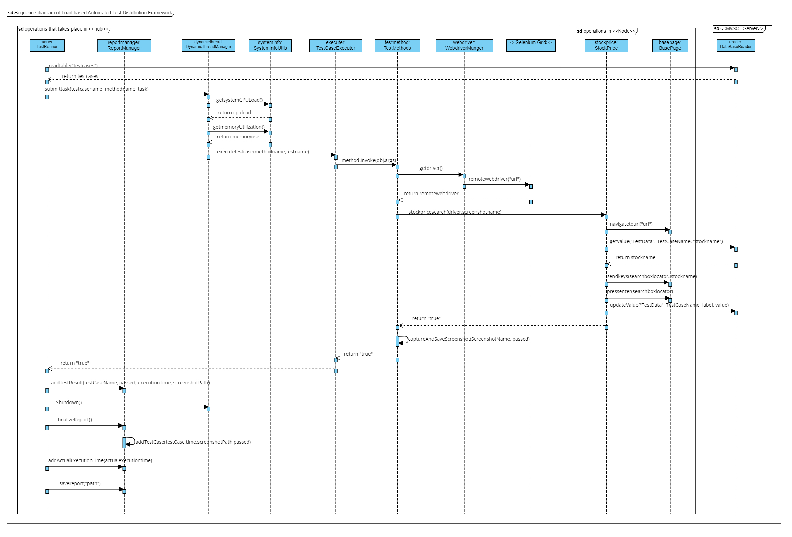
Behavioral Model:
Sequence diagram:
This diagram showcases the dynamic behaviour of the system, particularly focusing on the sequence of messages exchanged between various objects during the execution of test cases. It includes interactions among key components like the Test Runner, Selenium Grid, Nodes, and Database, clearly depicting how these elements collaborate to execute and manage test cases.
Fig: Sequence diagram of Load Based Automated Test Distribution Framework

Slide 11
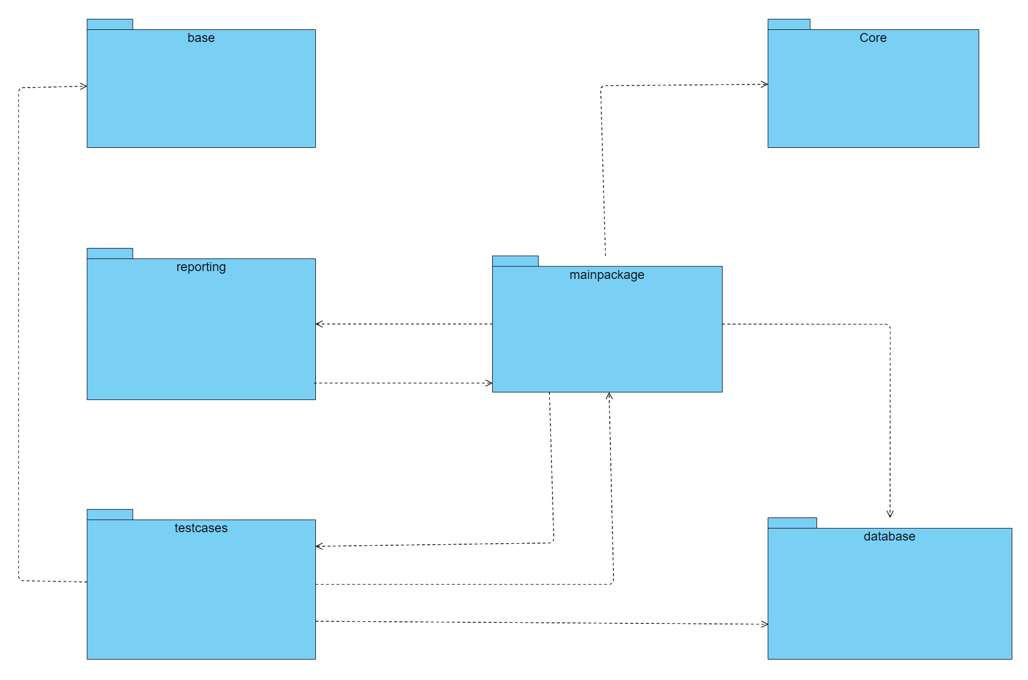
Design Model:
The Design Model, encapsulates the structural arrangement of the Java Selenium Framework
Package diagram:
The diagram provides a more comprehensive view of the framework, highlighting the interactions between different packages.
Fig: Package diagram of Load Based Automated Test Distribution Framework.

Slide 12
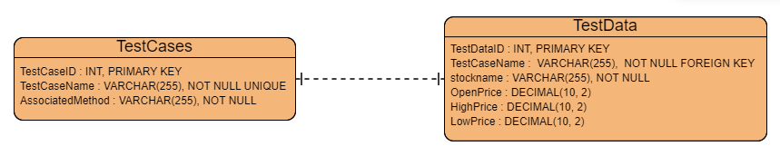
Data Management Layer Design:
The Data Management Layer Design in this project, focuses on how data is structured and managed within the Java Selenium Framework. This design includes a detailed database schema.
Database schema:
The database schema for the "Optimizing Java Selenium Framework with Automated Test Distribution and Full Resource Utilization" project includes two main tables - TestCases and TestData. These tables are crucial for storing and managing test-related data and their execution outcomes, as visualized in the provided diagram.
Fig: database schema for the Java Selenium Framework

Slide 13
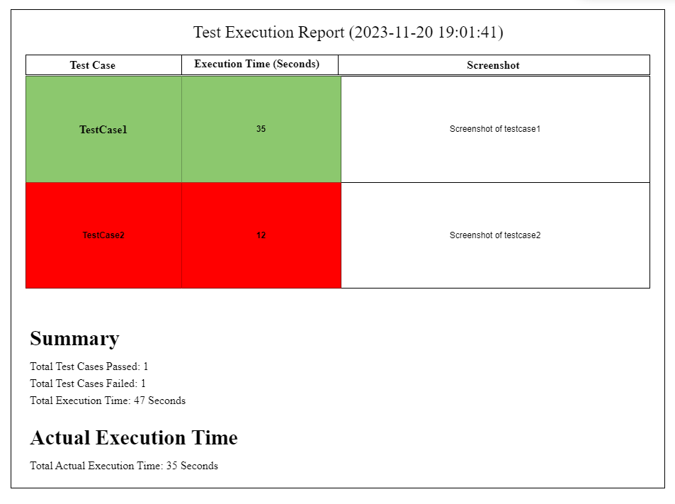
Human-Computer Interaction Layer Design:
Wireframe design of Test Report:
The wireframe presents a structured view of the Test Execution Report for the "Optimizing Java Selenium Framework" project. The report is delineated into several key sections, visually represented with clarity and emphasis on the outcomes of the test cases.
Fig: wireframe diagram of Test Execution Report for the Optimizing Java Selenium Framework

Slide 14
Specification | Standard Client | Standard Database Server
Operating System | Windows 10 / Chrome Browser 90 | Linux Ubuntu 20.04 LTS
Special Software | Java Runtime Environment (Java SE 17) Selenium Grid 4.0.0 | MySQL Server 8.0
Hardware | 16 GB Memory / 512 GB SSD / Intel Core i7 or similar | 16 GB Memory / 1-2 TB HDD / Intel Xeon or similar
Network | 100 Mbps Ethernet or High-speed Wireless | 100 Mbps Ethernet
Physical Architecture Layer Design:
Hardware and Software Specification Overview:
For the design of Java Selenium Framework with Automated Test Distribution and Full Resource Utilization, we just need a client where our program runs and a database server to store testcases related data as shown in Fig: Summary Table of Hardware and Software Specifications.
Fig: Summary Table of Hardware and Software Specifications

Slide 15

Acknowledgement:
I express my profound gratitude towards John Doe, VP of Quality Assurance, for his invaluable guidance and support. My sincere thanks go to my mentor Venkat for his insightful advice and encouragement. I'm also grateful to my colleagues at WeThink Technology Solutions and the technical team for their assistance and inspiration throughout this journey. Their contributions were pivotal in the successful completion of this project.

Slide 16
Conclusion The "Optimizing Java Selenium Framework" project successfully enhanced automated testing efficiency, achieving a 30% reduction in test execution time and improved scalability. It introduced dynamic thread allocation and load-based distribution, leading to resource optimization and cost savings, significantly bolstering our competitive edge in the market.

